Slide 1
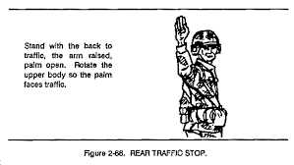
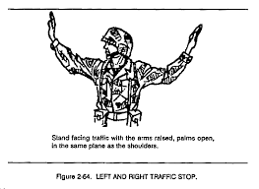
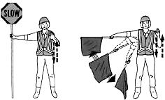
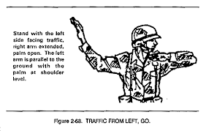
Reference Handout for CERT Traffic Management
SLOW DOWN
Movement of hand, flag or light
Is good way to get attention.
Note that change of direction signals
should start in center and emphatically
point to movement direction desired.

Slide 2
Traffic Management
CERT Supplemental Training
Module 2

Slide 3
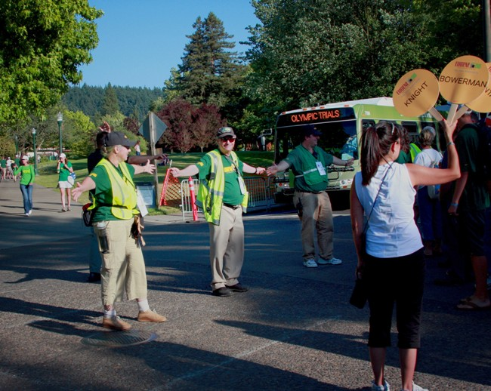
Module Objective
To provide CERT members with skills needed to manage traffic in planned and emergency situations
Hand Signals
Organization
Team Safety

Slide 4
What Do You Think?
When might CERT assist in the management of traffic?
Unplanned Incidents like traffic accident, weather hazard, or natural or manmade disaster
Planned Events like parades, funeral procession, or training exercise
Notes:
3

Slide 5
Management vs. Control
CERT manages traffic and crowds – CERT members provide coordination and regulation for drivers and pedestrians to facilitate movement.
CERT does not control traffic or crowds -- control implies the use of force, and CERT members are not trained to exert force over drivers or pedestrians.
Notes:
4

Slide 6
CERT Role in Traffic Management
Direct safe flow of traffic with hand signals and traffic control devices
Provide safe passage for pedestrians
Communicate and coordinate with team members
Keep team leaders and chain of command informed about situation
Maintain personal and scene safety
Notes:
5

Slide 7
Personal Safety
Remain alert at all times; stay aware of the traffic at your back and your buddy’s back
Actively seek eye contact with drivers
Be sure you can see workers next to you and make sure radios are working and hand signals understood by all
Wear correct attire to be highly visible
Do not give signals against a traffic light or wave hands or flag other than for signal
Notes:
6

Slide 8
Personal Safety (cont’d)
Do not have unnecessary conversation with workers, pedestrians, or drivers
Clear, respectful communication can prevent negative encounters
Back away from dangerous situations
Watch out for out-of-control vehicles or confused drivers
Recognize personal limits and ask for help or relief before you are stressed out
Notes:
7

Slide 9
CERT Leaders and Scene Safety
Keep team members and IC/TL aware of what is going on around them
Recognize signs of a dangerous situation – if it feels wrong, it probably is
Have backup available; pay attention to personal limitations
Watch for signs of stress and relieve team members regularly (1 to 3 hours)
Be respectful and courteous with drivers
Notes:
8

Slide 10
CERT Worker Attitude
You are the person in charge
You must manage the operation in a clear way to avoid confusion and chaos
Be courteous, calm, and precise
Do not be intimidated
Directing crowds and traffic relies on clear vision, common sense, good judgment, and good communication
Most people want to cooperate
Notes:
9

Slide 11
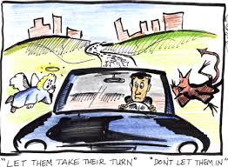
Behavior to Report
Aggressive or uncooperative drivers or pedestrians
Noncompliance
Rushing
Hostility
Report license number or description of vehicle
Notes:
10

Slide 12
Local Rules and SOP
Insert local ordinances and state statutes that pertain to traffic and crowd management here.
Notes:
11

Slide 13
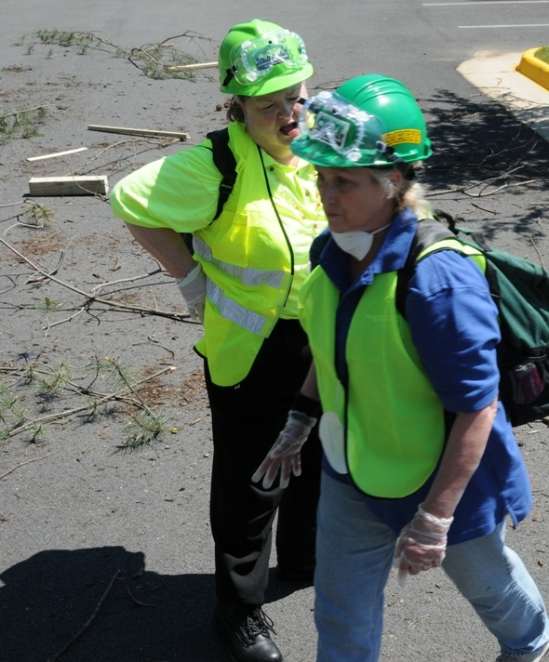
CERT Sizeup
Use sizeup whenever CERT is deployed for traffic incident without firefighters on scene to direct actions
Same 9-step process as with fire or medical sizeup

Slide 14
Traffic Hand Signals
Make signals emphatic
Keep hands high
Use whistle
Make eye contact with signaled driver
Keep watch all around you
Notes:
13

Slide 15
Exercise
Practicing Hand Signals
Stop
Go ahead
Slow down
Move to the right
Turn left
Notes:
14

Slide 16
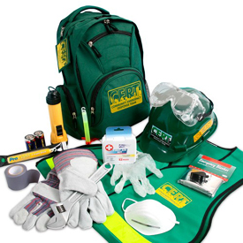
Equipment for Directing Traffic
Proper equipment essential
Makes flag person more visible
Helps drivers recognize you as person directing traffic
Equipment needed
Reflective vest (required by Federal law)
Stop paddle or flag
Radio
Flashlight
Road flares or traffic cones
Warning signs
Notes:
15

Slide 17
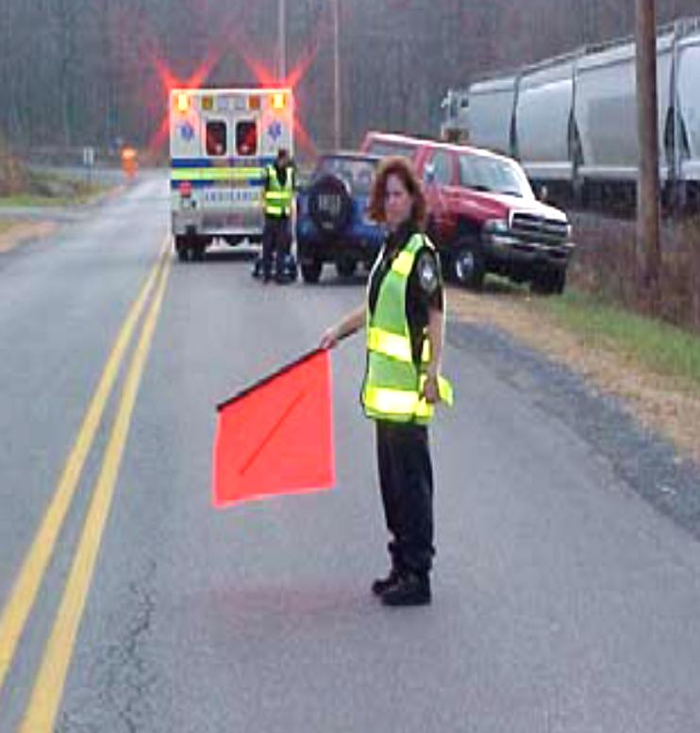
Flag Persons
When to use flag persons
Travel lanes are partially blocked
Shoulder can be used to pass by incident
Only one direction of traffic is available
One person must be in charge and be watchful for safety problems
Use flag, light or
STOP/SLOW sign
Notes:
16

Slide 18
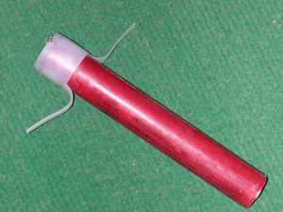
Using Flares and Cones
Uses for flares and cones
To funnel traffic
To direct it along alternate routes
To separate vehicles from incident
Still need safety observers at each end to help drivers
Notes:
17

Slide 19
Using Flares

Slide 20
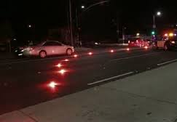
Flare and Cone Patterns
Set flare and cone patterns
20-25 feet apart in straight line
At gradual angle when directing lane change
To one side of incident
With flag person at each end
Caution: Be alert for vehicles driving through patterns

Slide 21
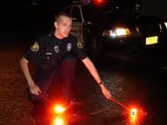
Benefits and Limitations of Flares
Benefits
Gain driver’s attention
Automatically indicate emergency
Work day and night
Limitations
Can cause fire
Can burn user
Limited to 15-30 minutes
Notes:
20

Slide 22
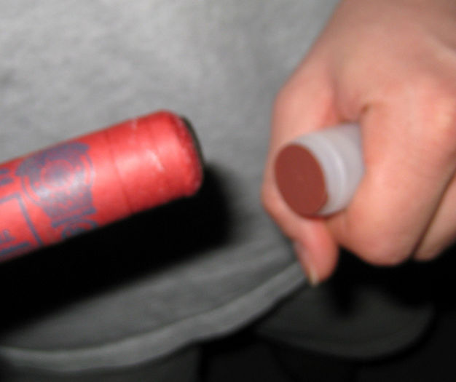
Igniting Flares
Point flare away from your body and down and pull off protective cap
Turn face away from flare and strike down away from your body
Striking surface may retain hot residue
Notes:
21

Slide 23
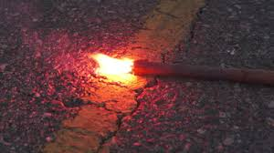
Extinguishing Flares
Pick up flare (if long enough) and tap lit end on ground until flare goes out
Do not throw or step on flares to put them out
May be safest to allow to burn out
Notes:
22

Slide 24
Flare Safety Tips
Always wear protective equipment such as gloves and goggles
Do not light flares near fire hazards such as leaking gas, hazardous materials, dry grass or when windy
Never hold flare above your head and shoulders, as molten material drips from end of flares and can cause burns
Notes:
23

Slide 25
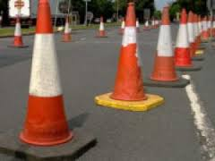
Benefits and Limitations of Cones
Benefits
More practical than flares if incident will last long
Don’t burn out
Require little attention
Limitations
Can not be seen from as far a distance as flares
Are bigger than flares and harder to transport in large amounts
Notes:
24

Slide 26
What Do You Think?
While managing traffic as squad leader, what can you do to keep your team safe?
What should you do if some driver
refuses to follow your directions?
How long should any one person be on duty at the center of an intersection?
Notes:
25

Slide 27
Scene Safety at Traffic Incident
Have one person in charge of the situation
Make sure all members are in communication
Don’t start traffic until you communicate with other end of traffic control scene
Don’t leave your station until properly relieved
Keep traffic slow past incident
Look out for inattentive drivers
Give clear, concise hand signals
Be polite but decisive to drivers
Use verbal orders as little as possible
Notes:
26

Slide 28
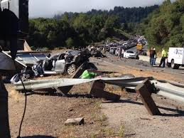
Traffic Situations
CERT members may help manage traffic on:
Straight roads
Curved roads
Intersections
CERT members should NEVER direct traffic on freeways
Notes:
27

Slide 29
Straight Roads
One person
(Undesirable)
Flagger
Incident
Notes:
28

Slide 30
Straight Roads
More than one person (safer)
Flagger
Flagger
Incident
Each flagger must be able to see the other.
Notes:
29

Slide 31
Curved Roads
If flaggers cannot see each other,
place another flagger so they can.
Flagger
Incident
Flagger
Notes:
30

Slide 32
4-Way Intersection
Most hazardous traffic operation that CERT members may be asked to perform
Stand where you can see all traffic and drivers can see you; have buddy to help
Signal drivers in time to stop before they reach crosswalk of intersection
Clear intersection before allowing opposite traffic to proceed
Watch traffic flow -- don’t let too many cars build up in any direction

Slide 33
4-Way Intersection
One Person
(undesirable)
Flagger
Incident
Notes:
32

Slide 34
4-Way Intersection
More Than One Person
Flagger
Flagger
Flagger
Flagger
Incident
Leader coordinates all 4 flaggers
Notes:
33

