Slide 1
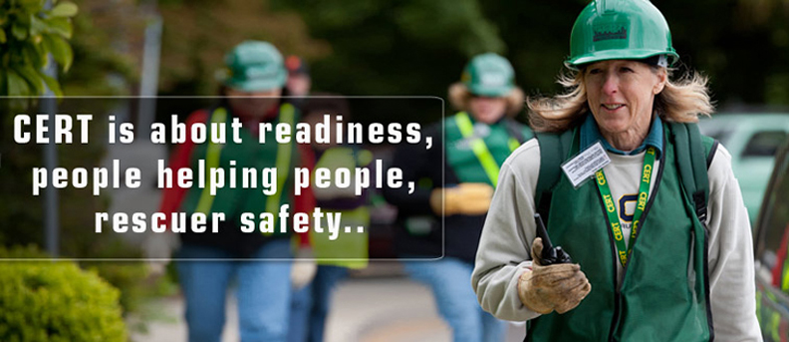
Disaster Preparedness
CERT Basic Training Course (Community Emergency Response Team)
Unit 1- Disaster Preparedness

Slide 2
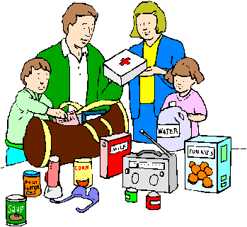
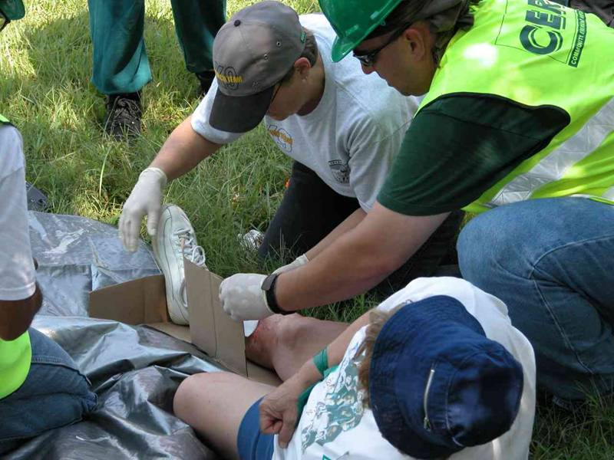
Setting the Stage–Course Goals
To prepare your family and home for any emergency
To help you educate neighbors about potential disasters and needs
To assist family and neighbors during time of disaster
To work SAFELY as part of an emergency team
DO THE MOST GOOD FOR THE MOST PEOPLE

Slide 3
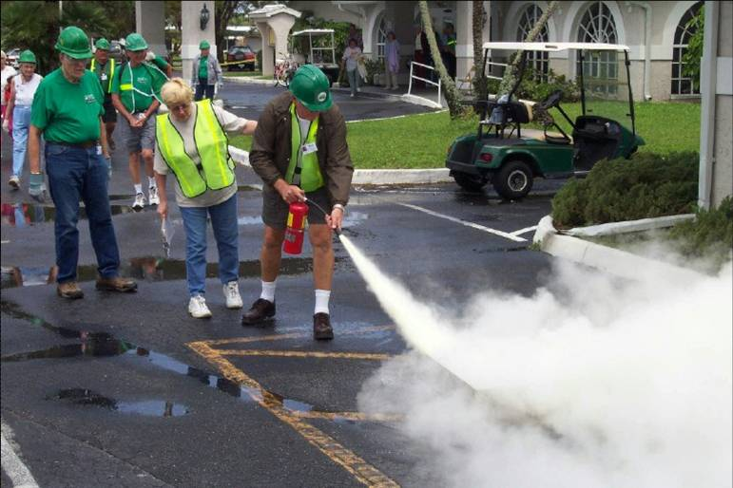
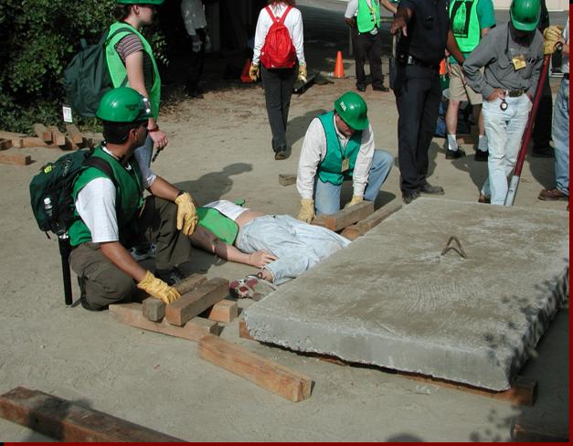
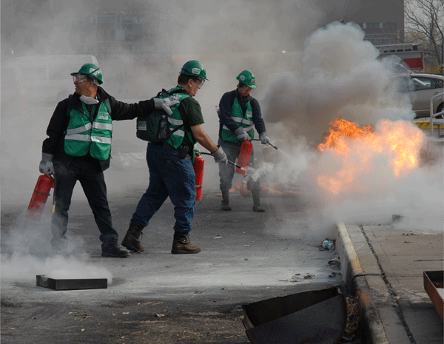
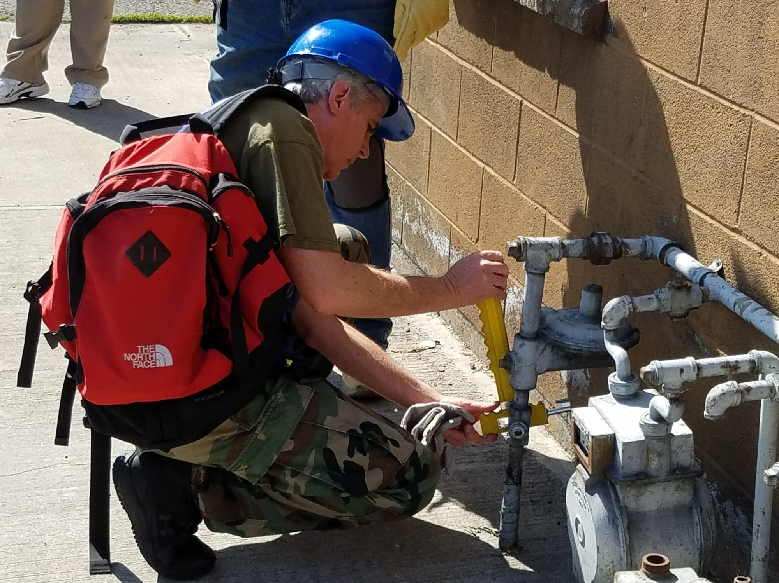
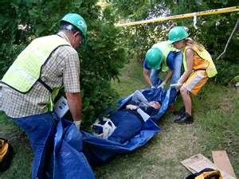
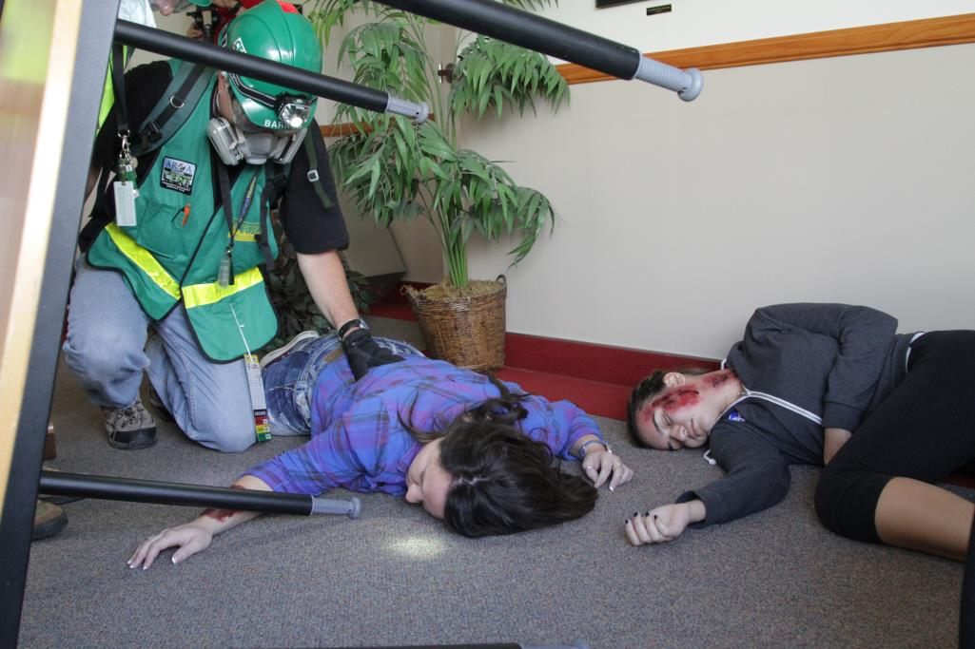
Setting the Stage-CERT Support
Fire, Search, Rescue,
Utilities, Medical

Slide 4
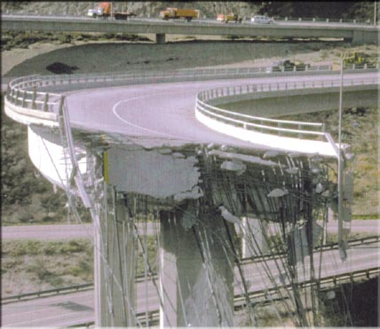
Setting the Stage-CERT Support
  1994 L.A. earthquake (mag 6.7;moderate)
  71 Deaths; 9,196 Injured
  CERT Support in
  local neighborhoods
    Firefight - 5
    Search - 203
    Rescue - 17
    Utilities - 156
    Medical - 57

Slide 5
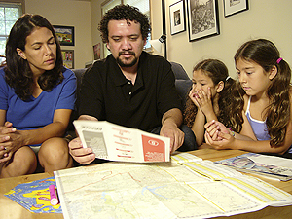
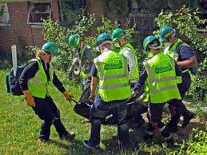
CERT Course Overview
It starts with you and your family to prepare before an emergency
It’s a TEAM concept – one person alone cannot work well in a disaster
Both knowledge and skills are needed to succeed
(Manual pages 7 to 9)
Notes:
4

Slide 6
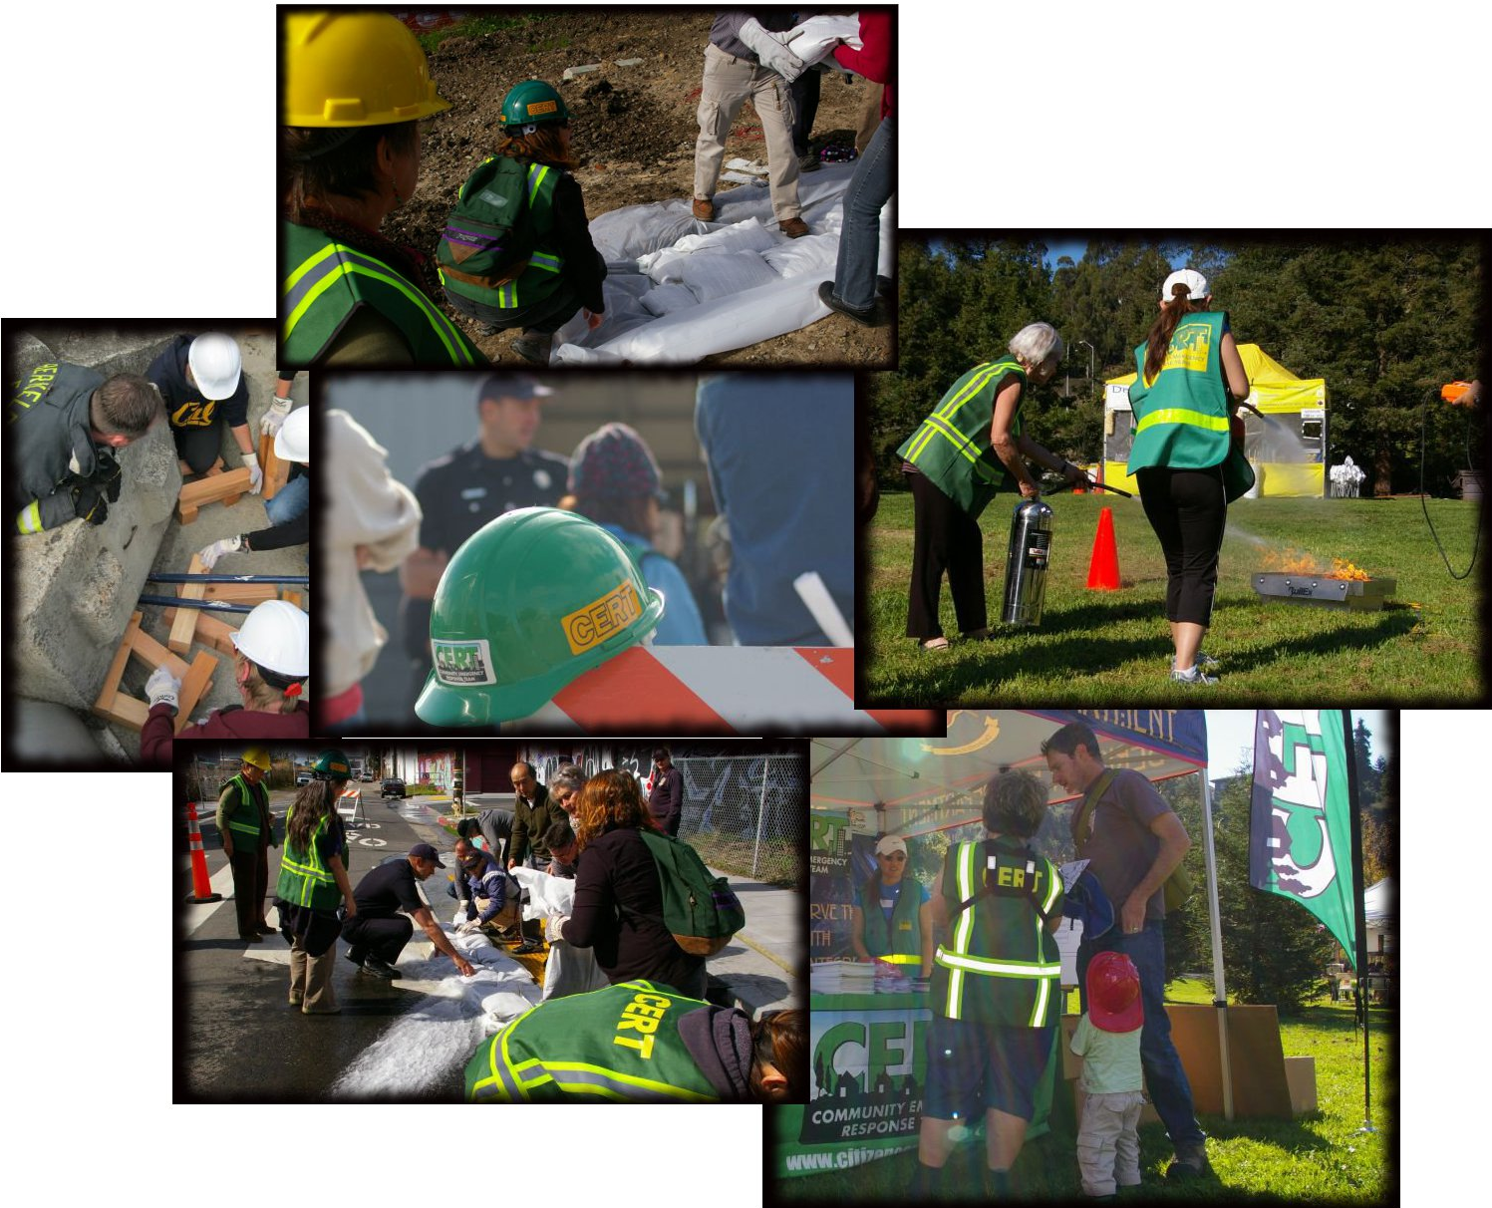
CERT Course Overview-Unit 1
Disaster Awareness
Community Preparedness
Personal and Family Actions
CERT Overview
Notes:
5

Slide 7
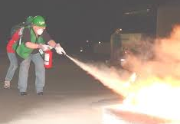

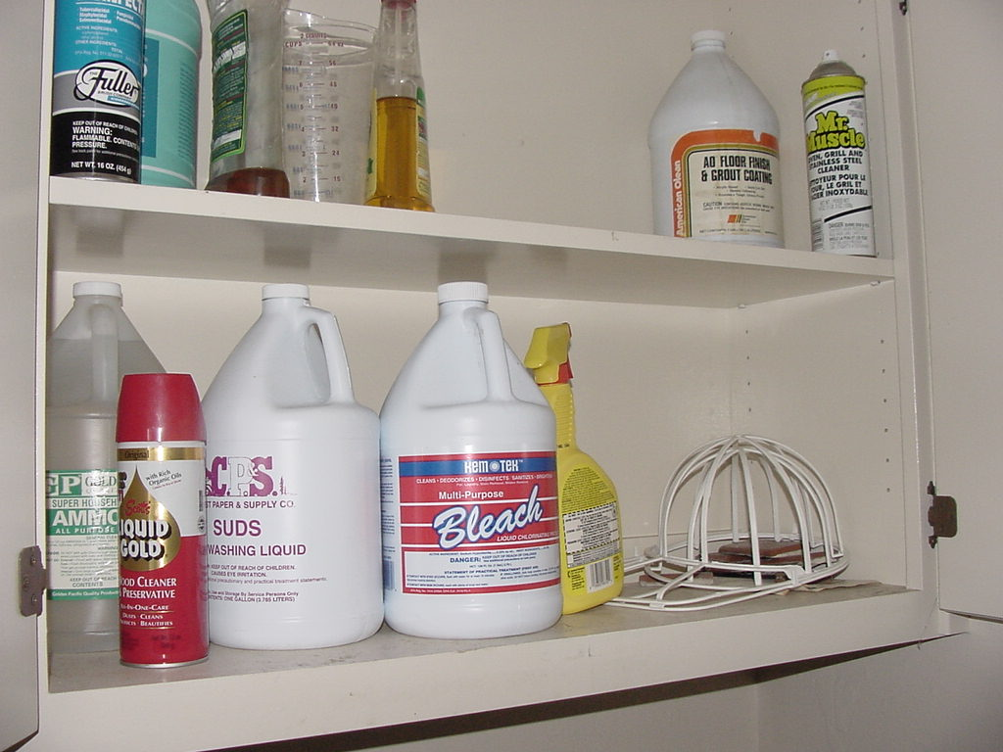
CERT Course Overview-Unit 2
Fire Suppression with extinguisher
Utility Control
Hazardous Materials
Notes:
6

Slide 8
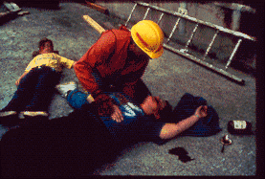
CERT Course Overview-Unit 3
Disaster Medicine
Life–threatening conditions (Airway, Bleeding, Shock)
  40% of 400,000 deaths in 1976 China Quake (like SF 1906) could have been saved by disaster medicine!
Notes:
7

Slide 9
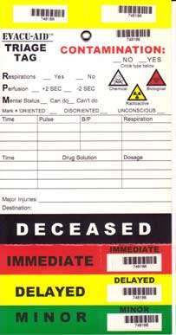
CERT Course Overview-Unit 4
Disaster Medical Operations
Triage to determine who needs help the most
Head-to-Toe Assessment
Medical Treatment Area
Notes:
8

Slide 10
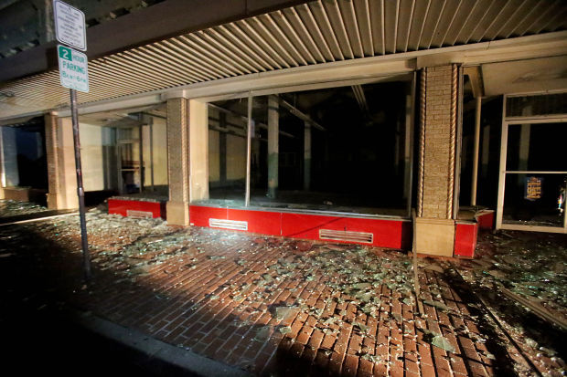
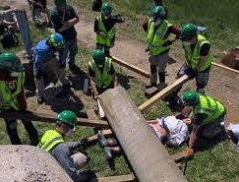
CERT Course Overview-Unit 5
Building construction types
Degrees of damage and safety
Light Search & Rescue
Notes:
9

Slide 11
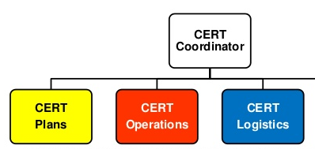
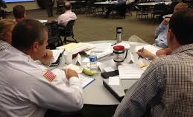
CERT Course Overview-Unit 6
Disaster Management (national standard)
CERT Organization
Table Top Exercise
Fire Dept
Team Leader
Notes:
10

Slide 12
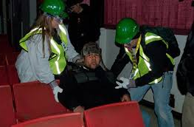
CERT Course Overview-Unit 7
Disaster Psychology
Disaster Trauma
CERT team well-being
Notes:
11

Slide 13
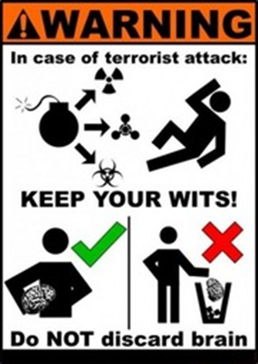
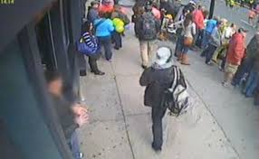
CERT Course Overview-Unit 8
Terrorism Indicators
Terrorism and CERT
Possible terrorism is STOP sign for CERT!
Boston 2013
Notes:
12

Slide 14
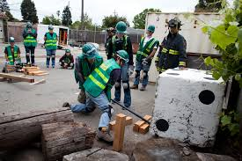
CERT Course Overview-Unit 9
Review
TEST
  Written
  Hands On
Notes:
13

Slide 15
Unit 1 Objectives
Describe types of hazards that affect community, people, health, and infrastructure
Identify roles and responsibilities for community preparedness
Undertake personal and organizational preparedness actions
Describe functions of CERTs
(Manual pg 1-3)

Slide 16
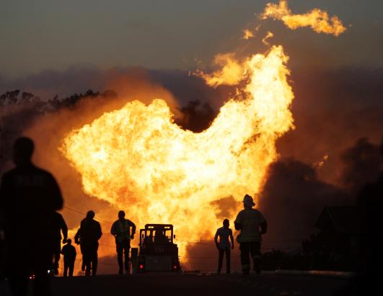
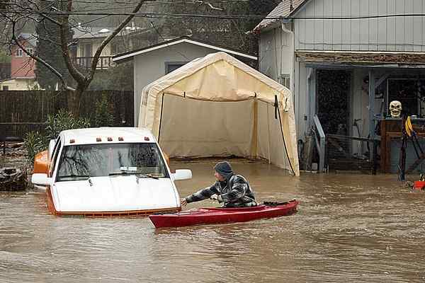
Disasters of All Kinds & Sizes
Key Disaster Elements
They are relatively unexpected
Lives, health, and the environment are endangered
Emergency services may be overwhelmed
Preparation by individuals and organizations will reduce the impacts
San Bruno Sep2010
Felton Feb2017

Slide 17
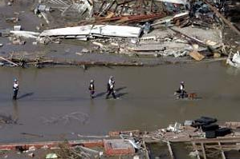
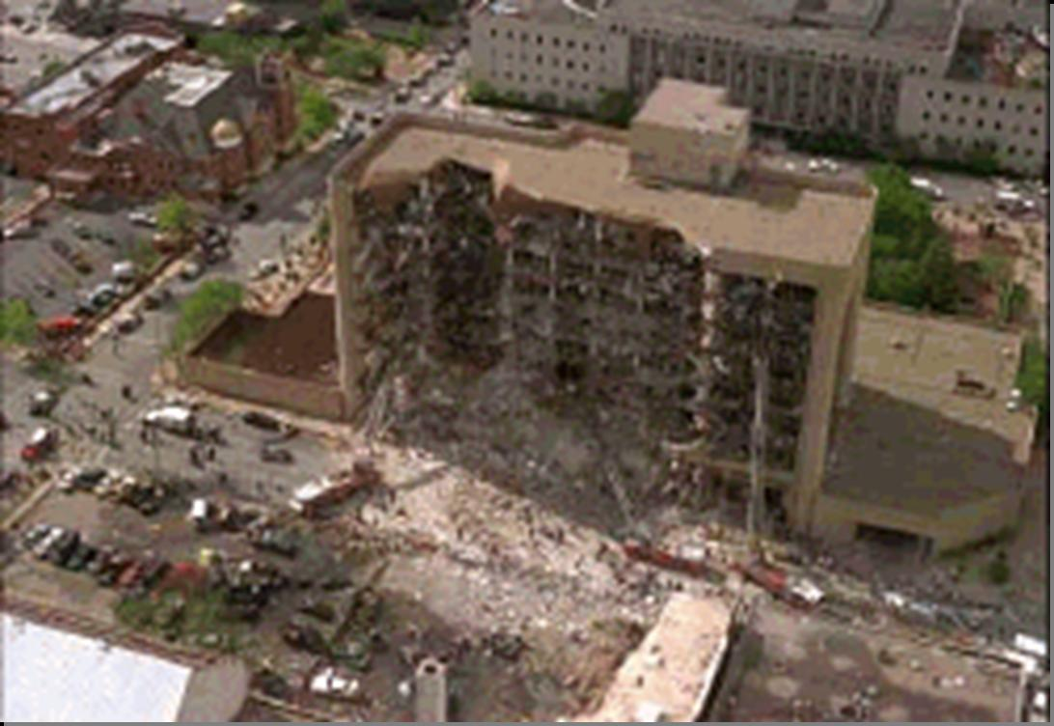
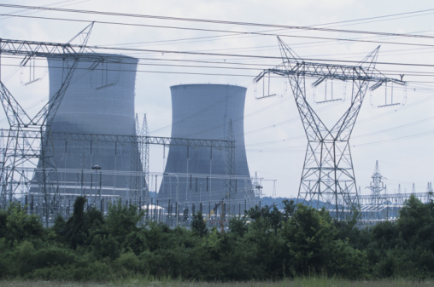
Types of Disaster
Natural (earthquake, storm, wildfire, disease)
Technological (power plant, computer hack)
Intentional (hazardous material, terrorism)
(Manual pg 1-7)

Slide 18
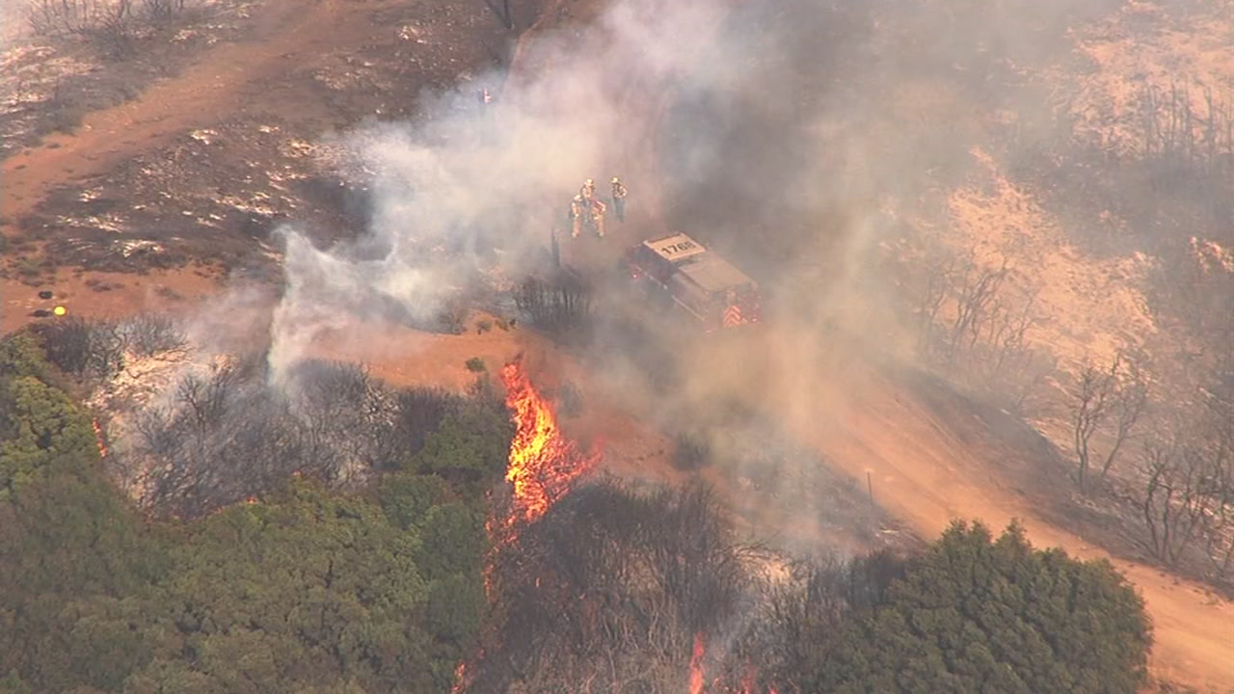
Damage to Infrastructure
Police: respond only to incidents of grave public safety
Firefighters: suppress only major fires
EMS personnel: handle life-threatening injuries
Lower priority needs met by neighborhood & organization volunteers
(Manual pg 1-9)
Loma Fire Sept2016

Slide 19
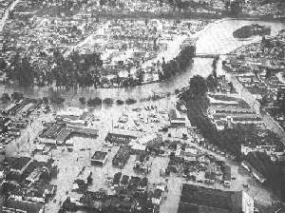
Local Disasters
Drought-Fire-Flood cycle:
  1875-1877 Drought, 1877 Fire, 1878 Flood.
  1897-1898 Drought, 1898 Fire, 1899 Flood.
  1975-1977 Drought, 1977 Fire, 1978 Flood.
  NOW!
Wind Storms & Waves
Landslide/Mudslide
Roads Washed Out
Earthquakes (guaranteed!)
Downtown
Santa Cruz 1955

Slide 20
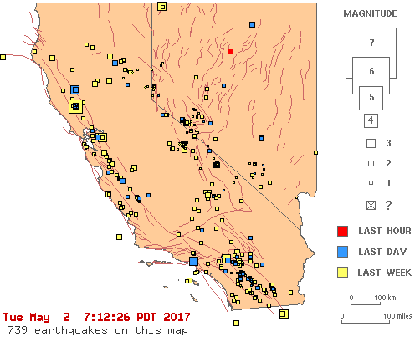
Local Earthquakes
Recent seismic activity in CA
Website:
http://scedc.caltech.edu/ recent/
Notes:
NOTE: get updated map from website for each class.

Slide 21
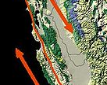
Local Earthquakes
1857 7.9 southern CA San Andreas
1865 6.5 Santa Cruz mountains
1868 6.7 Bay Area (Hayward Fault)
1906 7.9 north San Andreas Fault
1923 7.2 North Coast (San Andreas)
1964 9.2 Alaska (Aleutian Is.)
1984 6.2 Morgan Hill
1989 6.9 Loma Prieta
2014 6.0 Napa
Notes:
NOTE: get updated map from website for each class.

Slide 22
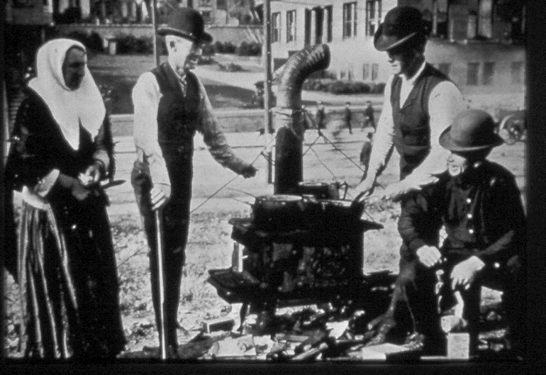
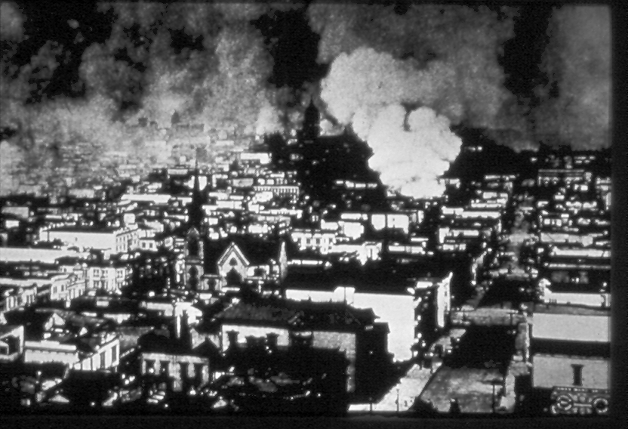
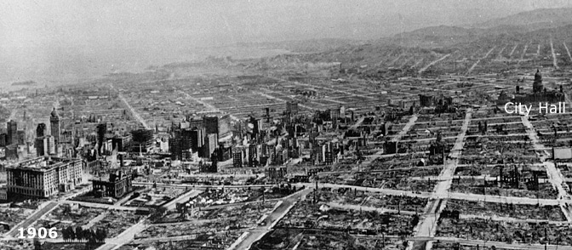
Local Earthquakes
1906 San Francisco earthquake
7.9 Richter Scale (“100 yr” earthquake)
  Shaking lasted almost a minute
  Approximately 3000 deaths
  500 square blocks destroyed by fire as water mains broke
Notes:
NOTE: get updated map from website for each class.

Slide 23
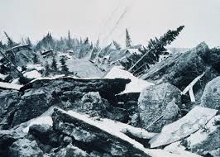
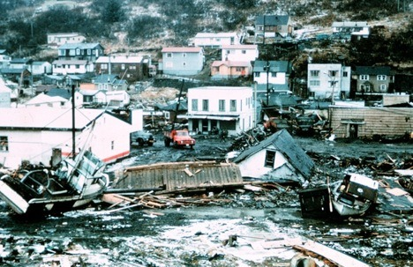
Local Earthquakes
  1964 Alaska earthquake
    9.2 Richter scale (biggest in North America)
    Shaking lasted over 4 minutes
    139 deaths (12 in CA due to tsunami!)
Main street Anchorage, AK
Downtown Crescent City, CA
Notes:
NOTE: get updated map from website for each class.

Slide 24
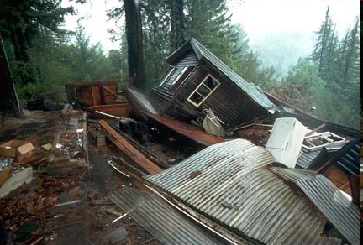
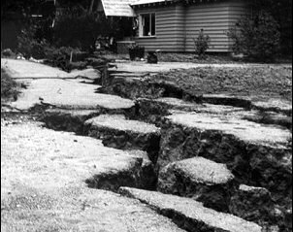
Local Earthquakes
  1989 Loma Prieta earthquake
    6.9 Richter scale
    Shaking lasted about 15 seconds
    64 deaths; $10 billion losses
1/10th strength of San Francisco
Near Summit Road
Notes:
NOTE: get updated map from website for each class.

Slide 25
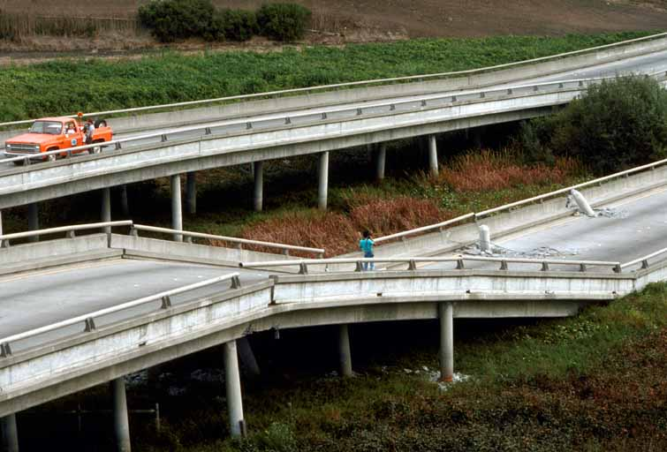
Local Earthquakes
  1989 Loma Prieta earthquake Highway 1 damage at Larkin Slough as supports pierce roadway
Notes:
NOTE: get updated map from website for each class.

Slide 26
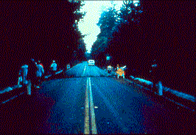
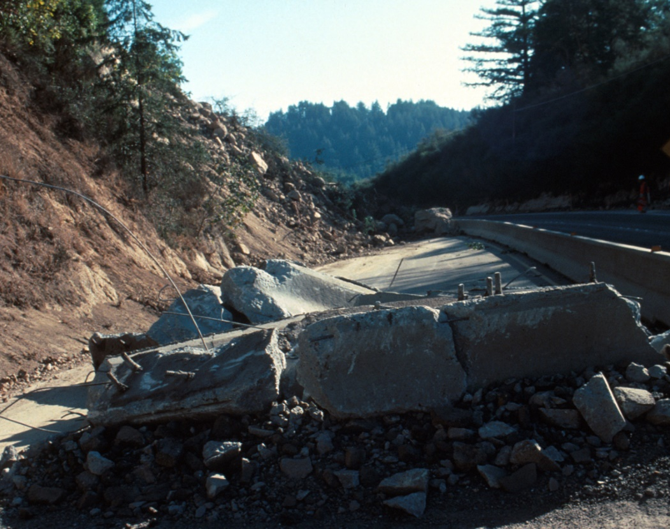
Local Earthquakes
  1989 Loma Prieta earthquake Highway 17 damage at Summit Road
Crack due to sideways slip
Roadway breakage & landslide
Notes:
NOTE: get updated map from website for each class.

Slide 27
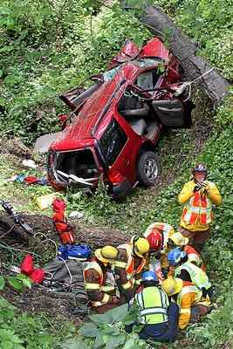
Local Earthquakes
Calls for local fire dept in 1989 Earthquake
21 Medical Emergencies
33 Utility Problems
11 Structure Collapses
6 Fires (5 after power restored)
48 Requests for Assistance
Over 100 emergency calls for a district with daily staffing of 3 engines
Notes:
NOTE: get updated map from website for each class.

Slide 28
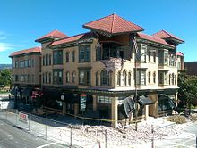
Local Earthquakes
2014 Napa earthquake
  6.0 Richter Scale
  1 Death; 250 Injured (falling debris)
  613 Buildings damaged
  Road Damage $362 million
Notes:
NOTE: get updated map from website for each class.

Slide 29
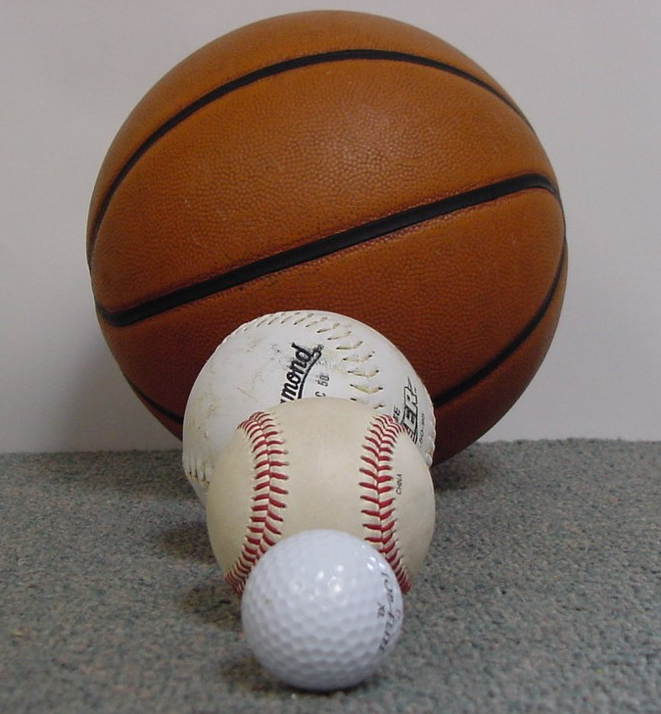
Local Earthquakes
Visualizing earthquakes
Golf ball 6.0 Napa quake
Softball 6.9 Loma Prieta
Basketball 7.9 San Francisco
The “Big One” we are expecting is 7.9 or more
Notes:
NOTE: get updated map from website for each class.

Slide 30
Earthquake Impact
What to expect from the next earthquake--
Damage to structures
  Casualties? Gas leaks?
Damage to infrastructure
  Bridges, roads (Santa Cruz “island”)
Impaired communications
ATM machines not working
  Gas stations, groceries and wells
Medical support slow
(Manual pg 1-9)
Notes:
NOTE: get updated map from website for each class.

Slide 31
Earthquake Impact
One major vehicle accident would use all available resources of a fire department
Local hospitals go “code red”
Who will care for large number of victims during disaster?
City/county help may not be available for 72 hours (or longer!)
You will have to depend on yourself
CERT can help in neighborhood!
Notes:
NOTE: get updated map from website for each class.

Slide 32
Community Preparation
Full community participation is key priority in lessening the impact of disasters
  Governments at all levels
  Non-governmental organizations
  Businesses & Schools
  Individual citizens
Effective if consider unique attributes of community and engage whole community

Slide 33
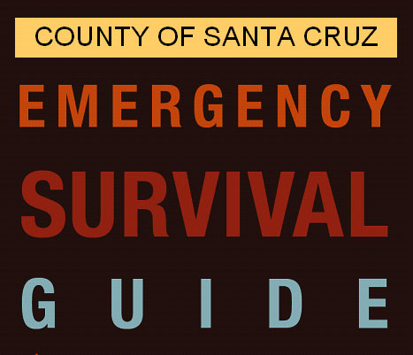
Government
Government has responsibility to:
Develop, test, and refine emergency plans
Ensure emergency responders have adequate skills and resources
    Fire and Rescue
    Medical
    Law Enforcement
    Public Works
(Manual pg 1-4)

Slide 34
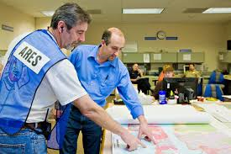
Emergency Operations Plan
Assigns responsibility to organizations and individuals & gives lines of authority
Describes how people and property will be protected
Identifies people, supplies, equipment, & facilities
Implemented by county EOC
(Manual pg 1-5)

Slide 35
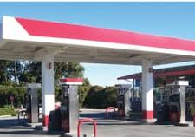



Businesses, Schools, Non-profits
Have a responsibility to participate in community preparedness
  Help local planning council
  Identify and integrate resources into government plans
  Ensure that facilities, staff, and customers served are prepared to cope
Mobilize volunteers

Slide 36



The Public – Families/Neighbors
Learn about community alerts, warnings, and evacuation plans & routes
Take volunteer training
Network and help others
Practice skills and personal plan

Slide 37


Engaging Entire Community
Citizen Corps works to help communities be safer, more prepared, & more resilient
VOAD Councils bring together volunteer groups and community leaders
Councils ensure emergency plans more effectively reflect the community
Notes:
VOAD = Voluntary Organizations Active in Disaster (county, state, national)

Slide 38


Family Disaster Preparation
Know local alerts, warning systems, evacuation routes, and sheltering plans
Address specific needs for yourself and people you know – what to do & where to go
Family Plan & Supply Kit
(websites in Manual pg 1-15)
ALSO: santacruzcountycert.org

Slide 39

Personal Preparation
Continuous: Be aware of surroundings
Even before a quake hits, look around and decide on the safest place for you if a quake happens at that time and place.
Carry whistle with you (it will last far longer than your voice to call for help!)
CERT Basic Training
Unit 1: Disaster Preparedness
1-35

Slide 40



Personal Preparation
First Actions: Duck, Cover & Hold On
If inside, STAY inside. 90% of those injured in a quake are hurt by falling objects. Glass is the biggest hazard – sharp & slippery!
If in your car, PULL OVER, stop, stay inside
CERT Basic Training
Unit 1: Disaster Preparedness
1-35

Slide 41

After-Disaster Actions
Assess situation; decide to stay or move
  Critical early decision in disasters
  Shelter in place or evacuate?
Seek clean air and protect breathing passages
Protect from debris and signal “help” if trapped
Remove contaminants
Practice good hygiene

Slide 42
Plan for After-Disaster Actions
Sealing a room to shelter in place:
  Identify internal room
  Stay for several hours
  Short-term supplies
Extended=stay shelter
  Stay for several days or up to 2 weeks
  Store emergency water and other supplies
Mass care or community shelter
  Bring 3-day disaster kits
  Shelters provide most supplies
Know which ones will take pets

Slide 43

Hazards Vary with Structures
Wood-framed homes have performed well in most types of disasters but damage will vary by structure
Significant differences between single-family homes and multiple-unit dwellings
Be aware of objects and exits in a room. If lights go out, how do you get out?

Slide 44

Hazards Vary with Structures
In public places like restaurants or stadium
Identify exit routes as you enter
  Look for two exits. Don’t put yourself in place where you can be trampled
  Avoid sitting under air conditioner or near windows
Get between the seats and cover your head & neck during a quake.

Slide 45

Hazards from Home Fixtures
Broken ceramics & glassware
Gas line ruptures due to displaced water heaters or ranges
Damage from falling books or cabinet contents
Electric shock or injury from displaced appliances, office equipment
Fire from faulty wiring, overloaded plugs, or frayed electric cords
Local kitchen after
1989 earthquake

Slide 46

Home & Workplace Readiness
Family Supply Kit
Assemble with whole family, so everyone knows what’s in it and where it’s stored.
Have correct size clothing for growing children.

Slide 47


Home & Workplace Readiness
Family Supply Kit
The most important item you’ll need is water (1 gal/person/day)
You can survive many days without food, but less than 1 week without water
Chart on page 1-23 of CERT manual describes bleach use

Slide 48



Home & Workplace Readiness
Family Supply Kit
Second most important item is food, even snack bars
Use foods that aren’t salty & don’t need much water
If you use cans, you need a manual opener

Slide 49

Home & Workplace Readiness
Family Supply Kit
Be sure to include medicines
A radio will give important information and may be able to charge your cell phone
If you have pets, remember pet food & extra water. Also a carrier to transport them
Flashlight & matches
Key stations:
KSCO 1080AM
KCBS 740AM
KDON 102.5FM

Slide 50


Home & Workplace Readiness
Other Supply Kit items
Duct tape can make a splint or repair many items
With scissors you can make bandages from clothing
Garbage bags can be poncho, window cover or toilet liner
Lists for first aid and family kits on pages 1-24 to 1-27 of CERT Manual.

Slide 51
Develop a Disaster Plan
Where will you meet family members?
Who is your out-of-state “check-in” contact?
What determines if you shelter in place? Evacuate?
How will you escape your home? Workplace? School? Other?
What route (and several alternates) will you use to evacuate your neighborhood?
Do you have transportation?
Did you practice your plan?

Slide 52


Escape Planning
Consider needs of children and individuals with disabilities
Two exits from each room without being locked
Inform all family members or office coworkers of the plan
Run practice escape drills

Slide 53
Home Preparation for a Disaster
Mitigation reduces loss of life or property by lessening the impact of disasters
  Actions on home structures or utilities
  Actions inside home
CERT members should have adequate homeowners coverage (with flood insurance if in flood hazard area)
(Manual pgs 1-28 to 32)

Slide 54

Home Hazard Mitigation
Anchor heavy furniture
Move beds away from tall bookcases
Secure appliances and office equipment
Childproof cabinet doors
Secure water heaters and have flexible gas lines installed
Locate and label gas, electricity and water shutoffs

Slide 55


Other Mitigation Measures
Secure house or mobile home to foundation or slab
Install trusses or hurricane straps to reinforce roof
Strap propane tanks and chimneys
Raise utilities above flood level
Build a safe room

Slide 56
Get Everyone Involved
Preparedness requires actions by all
  Talk to friends and family about hazards
  Ask about emergency planning outside the home
  Make sure those in charge have a plan
Training provides skills needed to help others and keep skills current
  CERT program provides training, practice, and connection to others
  Talk to friends and family about volunteering

Slide 57
CERT Disaster Roles
CERT members’ first responsibility is personal and family safety
Respond in period immediately after a disaster
Act as “bridge” for first responders in large disaster
Assist after a disaster:
  Locate and turn off utilities, if safe
  Extinguish small fires, if safe
  Triage injuries
  Conduct light search and rescue
  Help to relieve survivor stress

Slide 58


CERT Non-Disaster Roles
Identify neighbors or coworkers who might need assistance
Distribute preparedness materials; do demos
Staff information booths at special events
Assist with installation of smoke alarms
Parade route management

Slide 59


CERT Team Organization
Governmental Agency Liaison
Fire Department Officer
Much more in Unit 6
CERT Volunteers
CERT squads
(Manual page 1-34 modified)
CERT Basic Training
Unit 1: Disaster Preparedness
1-51
Notes:
PM pg 1-34

Slide 60

Personal Protective Equipment
Helmet
Goggles
N95 Mask
Gloves (work
and non-latex)
Sturdy personal shoes or work boots
Personal work clothes

Slide 61

Protection for Disaster Workers
CERT members generally protected by:
  “Good Samaritan” laws
  Volunteer Protection Act
  of 1997
  California State statutes and
  Health & Safety Code
Not liable for civil damages if acting in good faith as trained and without pay
(Manual pg 1-37/handout)

Slide 62
Unit Summary
You should now be able to:
  Identify roles and responsibilities for community preparedness
  Describe types of hazards that affect community, people, health, and infrastructure
  Undertake personal and organizational preparedness actions
  Describe functions of CERTs

Slide 63
Homework Assignment
Review manual information for Unit 1 (Bring questions to next session)
Read unit to be covered in next session
Discuss preparedness with family, friends and neighbors
Assemble supplies in multiple locations
Examine homes for hazards
Notes:
Manual pg 1-62 Item #3 says to bring leather gloves for “next” unit, but Unit 2 delayed in sequence to last meeting.

